Slide 1
File Systems
Introduction to Databases

Slide 2
Learning Objectives
Introduction to class.
Introduction to databases.
Files and file structures.
Critique of the file system.
Database systems.
Database models.
Evolution of database models.

Slide 3
Examples of Database Applications
Purchases from the supermarket
Purchases using your credit card
Booking a holiday at the travel agents
Using the local library
Taking out insurance
Using the Internet
Studying at university

Slide 4
File-Based Systems
Collection of application programs that perform services for the end users (e.g. reports).
Each program defines and manages its own data.

Slide 5
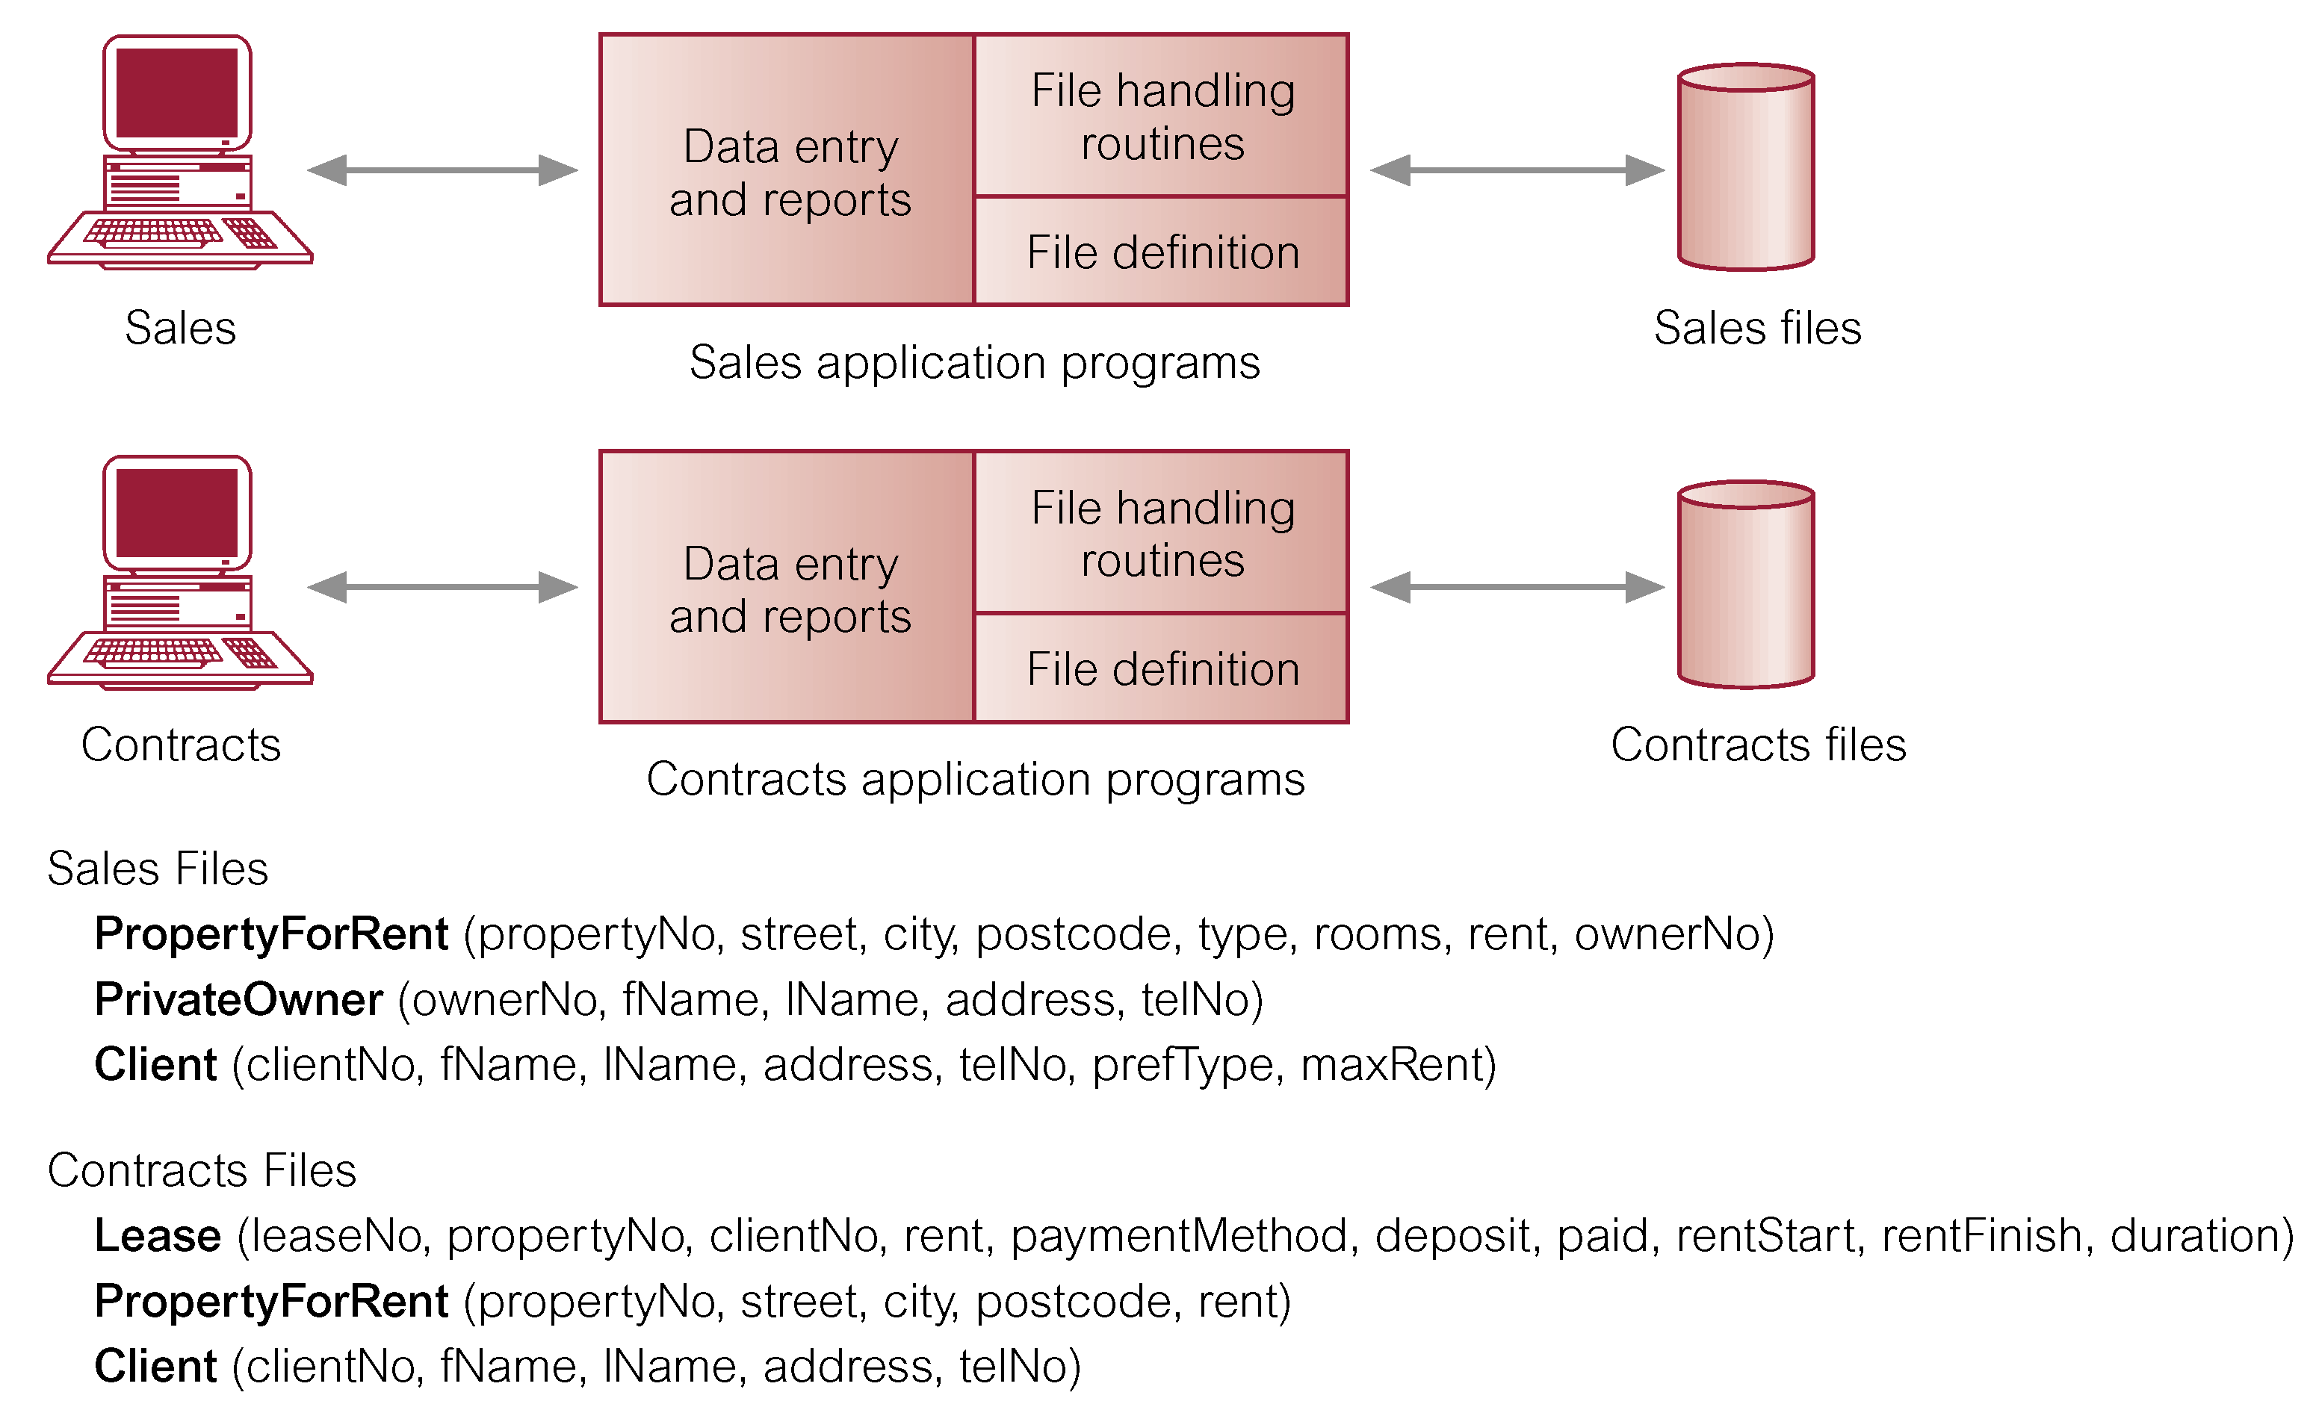
File-Based Processing

Slide 6
Limitations of File-Based Approach
Separation and isolation of data
  Each program maintains its own set of data.
  Users of one program may be unaware of potentially useful data held by other programs.
Duplication of data
  Same data is held by different programs.
  Wasted space and potentially different values and/or different formats for the same item.

Slide 7
Limitations of File-Based Approach
Data dependence
  File structure is defined in the program code.
Incompatible file formats
  Programs are written in different languages, and so cannot easily access each other’s files.
Fixed Queries/Proliferation of application programs
  Programs are written to satisfy particular functions.
  Any new requirement needs a new program.

Slide 8
Database Approach
Arose because:
  Definition of data was embedded in application programs, rather than being stored separately and independently.
  No control over access and manipulation of data beyond that imposed by application programs.
Result:
  the database and Database Management System (DBMS).

Slide 9
Database
Shared collection of logically related data (and a description of this data), designed to meet the information needs of an organization.
System catalog (metadata) provides description of data to enable program–data independence.
Logically related data comprises entities, attributes, and relationships of an organization’s information.

Slide 10
Database Management System (DBMS)
A software system that enables users to define, create, and maintain the database and that provides controlled access to this database.

Slide 11
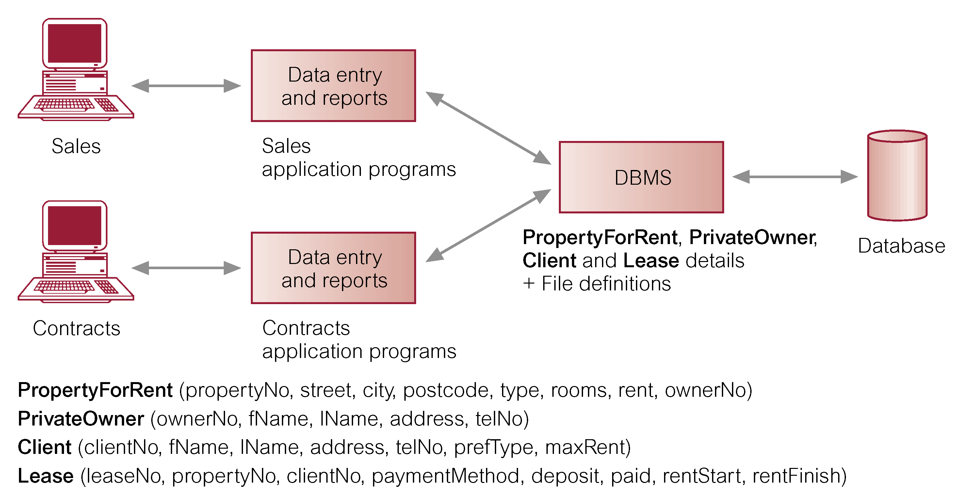
Database Management System (DBMS)

Slide 12
Database Approach
Data definition language (DDL).
  Permits specification of data types, structures and any data constraints.
  All specifications are stored in the database.
Data manipulation language (DML).
  General enquiry facility (query language) of the data.

Slide 13
Database Approach
Controlled access to database may include:
  A security system.
  An integrity system.
  A concurrency control system.
  A recovery control system.
  A user-accessible catalog.
A view mechanism.
  Provides users with only the data they want or need to use.

Slide 14
Views
Allows each user to have his or her own view of the database.
A view is essentially some subset of the database.

Slide 15
Views
Benefits include:
  Reduce complexity;
  Provide a level of security;
  Provide a mechanism to customize the appearance of the database;
  Present a consistent, unchanging picture of the structure of the database, even if the underlying database is changed.

Slide 16
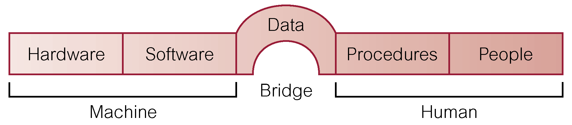
Components of DBMS Environment

Slide 17
Components of DBMS Environment
Hardware
  Can range from a PC to a network of computers.
Software
  DBMS, operating system, network software (if necessary) and also the application programs.
Data
  Used by the organization and a description of this data called the schema.

Slide 18
Components of DBMS Environment
Procedures
  Instructions and rules that should be applied to the design and use of the database and DBMS.
People

Slide 19
Roles in the Database Environment
Data Administrator (DA)
Database Administrator (DBA)
Database Designers (Logical and Physical)
Application Programmers
End Users (naive and sophisticated)

Slide 20
History of Database Systems
First-generation
  Hierarchical and Network
Second generation
  Relational
Third generation
  Object Relational
  Object-Oriented

Slide 21
The DBMS Marketplace
Relational DBMS companies – Oracle, Sybase – are among the largest software companies in the world.
IBM offers its relational DB2 system. With IMS, a nonrelational system, IBM is by some accounts the largest DBMS vendor in the world.
Microsoft offers SQL-Server, plus Microsoft Access for the cheap DBMS on the desktop, answered by “lite” systems from other competitors.
Relational companies also challenged by “object-oriented DB” companies.
But countered with “object-relational” systems, which retain the relational core while allowing type extension as in OO systems.

Slide 22
Hierarchical Database Model
History:
  North American Rockwell developed GUAM (Generalized Update Access Method)
  Mid 1960s Rockwell partner with IBM to create Information Management System (IMS)
  IMS DB/DC lead the mainframe database market in 70’s and early 80’s
  Represents well hoe components are decomposed into parts

Slide 23
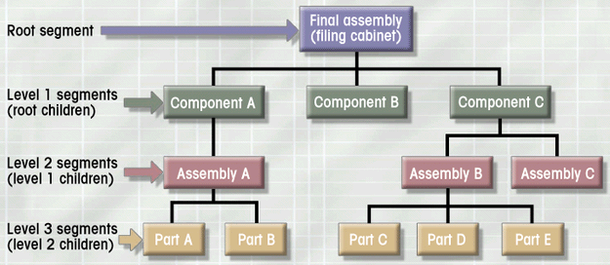
Hierarchical Database Model
Logically represented by an upside down tree
  Each parent can have many children
  Each child has only one parent

Slide 24
Hierarchical Database Model
Advantages
  Conceptual simplicity
  Database security and integrity
  Data independence
  Efficiency
Disadvantages
  Complex implementation
  Difficult to manage and lack of standards
  Lacks structural independence
  Applications programming and use complexity
  Implementation limitations (no M:N relationship)

Slide 25
Network Database Model
History:
  CODASYL (Conference on Data Systems Languages) created a group to work on standardization of databases: Database Task Group (DBTG)
  Identified 3 database component:
    Network schema (database organization)
    Subschema (views of database per user)
    Data management language

Slide 26
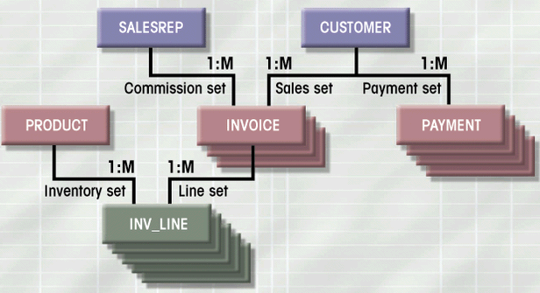
Network Database Model
Each record can have multiple parents
  Composed of sets - relationships
  Each set has owner record and member record
  Member may have several owners
  A set represents a 1:M relationship between the owner and the member
Figure 1.10

Slide 27
Network Database Model
Advantages
  Conceptual simplicity
  Handles more relationship types
  Data access flexibility
  Promotes database integrity
  Data independence
  Conformance to standards
Disadvantages
  System complexity
  Lack of structural independence

Slide 28
Relational Database Model
First developed by E.F. Codd (IBM) in 1970
First deployed on mainframe computers (DB2), then also personal computers
Oracle, Informix, SQL server, DB2

Slide 29
Relational Database Model
Perceived by user as a collection of tables for data storage
Tables are a series of row/column intersections (a row corresponds to a record, a column to a field)
Tables related by sharing common entity characteristic(s)
RDBMS

Slide 30
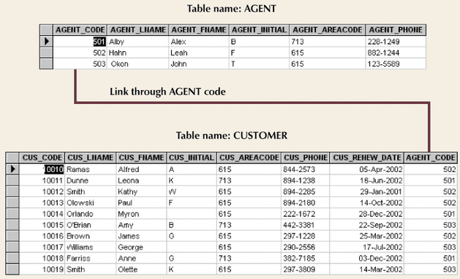
Relational Database Model (con’t.)
Figure 1.11

Slide 31
Relational Database Model
Advantages
  Structural independence
  Improved conceptual simplicity
  Easier database design, implementation, management, and use
  Ad hoc query capability with SQL
  Powerful database management system

Slide 32
Relational Database Model
Disadvantages
  Substantial hardware and system software overhead
  Poor design and implementation is made easy
  May promote “islands of information” problems

Slide 33
Advantages of DBMSs
Control of data redundancy
Data consistency
More information from the same amount of data
Sharing of data
Improved data integrity
Improved security
Enforcement of standards
Economy of scale

Slide 34
Advantages of DBMSs
Balanced conflicting requirements
Improved data accessibility and responsiveness
Increased productivity
Improved maintenance through data independence
Increased concurrency
Improved backup and recovery services

Slide 35
Disadvantages of DBMSs
Complexity
Size
Cost of DBMS
Additional hardware costs
Cost of conversion
Performance
Higher impact of a failure

Slide 36
Database Design
Database design deals with how to design a database
Importance of good design
  Poor design results in unwanted data redundancy
  Poor design generates errors leading to bad decisions
Practical approach
  Focus on principles and concepts of database design
  Importance of logical design

